Slide 1
CHC6173
Software Engineering
Lecture 3
Requirement Engineering

Slide 2
This Week’s Learning Outcomes
Part 1: Basic Concepts of Requirements Engineering
  The importance of RE
  The nature of RE
  The types and aspects of requirements
  The process of RE
Part 2: Requirements Elicitation Techniques
  Main techniques of requirements elicitation
  Understand their strengths and weaknesses, and conditions of uses
Part 3: Requirements Documentation
  Documentation skills and techniques
  Document structures

Slide 3
Lecture 3
Requirements Engineering
Part 1
Basic Concepts of Requirements Engineering

Slide 4
What is Requirements Engineering
  Requirements engineering is about discovery, understanding, formulation, analysis and obtaining agreement on what problem should be solved,
  why such a problem needs to be solved, and who should be involved in the responsibility of solving that problem.
  (Lamsweerder, 2010; p3)
The types of activities involved in RE
The goals of the activities
Notes:
Requirements Engineering
One of the main phases of a software development process
Sets real world goals for a software development project
Identifies functions (required services) as well as constraints on a software system
Defines a relationships between functions and constraints
Uses methods and tools in order to enable communication between developers, the clients, the end-users, and many other stakeholders
Is a broad subject, which involves different methods from different disciplines such as computing, maths, social sciences, and application domain

Slide 5
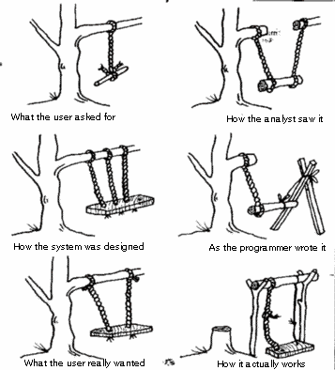
Why RE is important?
Good understanding of the requirements is necessary for developing a solid system
Requirements affect all phases of SD.
It is cheaper to fix problems if they are found earlier
RE is "The hardest single part of building a software system”
Frederick P. Brooks, 1987,
"No Silver Bullet: essence and accidents of software engineering ", IEEE Computer
Notes:
Source of the figure: http://www.cs.ucl.ac.uk/external/atanu/req.gif

Slide 6
The Nature of RE (1)
The aim of a project is to improve the world by building some machine expected to solve a specific problem
RE is concerned with the machine’s effect on the surrounding world.
Item delivered only if paid
Payment notification sent to seller
World
phenomena
Machine
phenomena
Shared Phenomena
The world
The machine
Payment record created in database
The shared phenomena define the interface through which the machine interacts with the world

Slide 7
What is software?
Software
  Software is a system consists of a program and a set of related documents
  Software is a component of a computer system
  A computer system is a component of the real world
Environment
  There are other components in the system
  They will generally pertain to the machine’s surrounding world
  Typical such components include:
    People or business units in the organisation
    Physical devices, such as sensors, actuators, measurement instruments or communication media
    Legacy, off-the-shelve or foreign software components

Slide 8
The Nature of RE (2)
Requirements engineering is concerned with the transfer from the system-as-is to the system-to-be.
The system-as-is:
  The system as it exists before the machine is built into it
The system-to-be:
  The system as it should be when the machine will be built and operated in it.
A system consists of a set of components interacting with each other to satisfy some global goals.
The components in a system can also be a system (i.e. subsystem).
While intrinsically composite, a system can be seen as a whole through the global properties emerging from component interaction.

Slide 9
Types of Requirements
Functional
Defines the functions performed and provided by a system
  Interactions between the system and its environment
    Exchange (input and/or output) of data between the system and its environment
    Change of system’s internal state
Non-functional
Describes a restriction or constraint that limits the choices for a system and its development
  Quality attributes
  Design constraints
    Features
    Compliance to standards
    Legal requirements, etc.

Slide 10
Functional Requirements
Functional requirements define the functional effects that the software-to-be is required to have on its environment
Examples:
  “The bibliographic search engine shall provide a list of all library books on a given subject.”
  “The train control software shall control the acceleration of all the trains in the system.”
  “The meeting scheduler shall determine schedules that fit the diary constraints of all invited participants.”
They address the WHAT aspects
This implies that there must be interactions between the software-to-be and its environment

Slide 11
Functions
Aspects of Functional Requirements
Data
The functions/services that the system should provide
The actors in the environment to interactions with
Output – what information is needed from the system
Input – what data has to be input to provide output
Data Storage – what is to be retained
States
Interfaces
The states of the system before and after the function is used and the intermediate states if any
The interface with the other components in the system that the function has accessed
Events
The event that triggers the function
The events generated by the function
The event performed after the function
11

Slide 12
Non-functional Requirements
They define constraints on the way the software-to-be should satisfy its functional requirements or on the way it should be developed.
Examples:
  “The format for submitting bibliographic queries and displaying answers shall be accessible to students who have no computer expertise.”
  “Acceleration commands shall be sent to every train every 3 seconds.”
  “The diary constraints of a participant may not be disclosed to any other invited participant.”

Slide 13
Taxonomy of Non-Functional Requirements
Confidentiality
Safety
Integrity
Security
Failure rate
Reliability
Availability
Quality requirements
Performance
Time
Space
Accuracy
Non-functional requirements
Usability
Compliance
User interaction
Interface
Convenience
Device interaction
Architectural constraints
Installation
Software interoperability
Distribution
Cost
Development constraints
Deadline
Variability
Maintainability

Slide 14
Aspects of Quality Requirements
Quality requirements should be specified with
  How to measure
  What is the target
Examples:
An e-Trade financial system developed for stock trading must be efficient in response time that guarantees order execution on stocks within 2 seconds.
A missile control system must respond to control signals within 100 milli-seconds.
Aspect | E-Trade Financial | Missile Control
Attribute: | Response time | Response time
Measurement unit | Second | Milli-second
Precision | 1 decimal | 1 decimal
Value | < 2.5 | < 58.5
14

Slide 15
RE Lifecycle: 1. Actors
Actors:
  People involved in the activities
  Stakeholder:
    The roles played by a group of individuals who is affected by the system-to-be, or may influence the way the system-to-be is shaped, or has some responsibility in its acceptance
  Examples:
    strategic decision makers, certification authorities
    managers of the operational units,
    domain experts,
    developers, subcontractors,
    end-users, customers, operators, etc.

Slide 16
RE Lifecycle: 2. Process
An ordered set of activities carried out by the actors
  Domain understanding
    Studying the system-as-is within its organizational and technical context
  Requirements elicitation
    Discovering candidate requirements and assumptions of the system-to-be
  Evaluation and agreement
    Aiming at making informed decisions about the issues raised during the elicitation process
  Specification and documentation
    Detailing, structuring and documenting the agreed characteristics of the system-to-be
  Requirements consolidation
    Validating specified requirements with stakeholders and verifying them against each other in order to find inconsistency and omissions

Slide 17
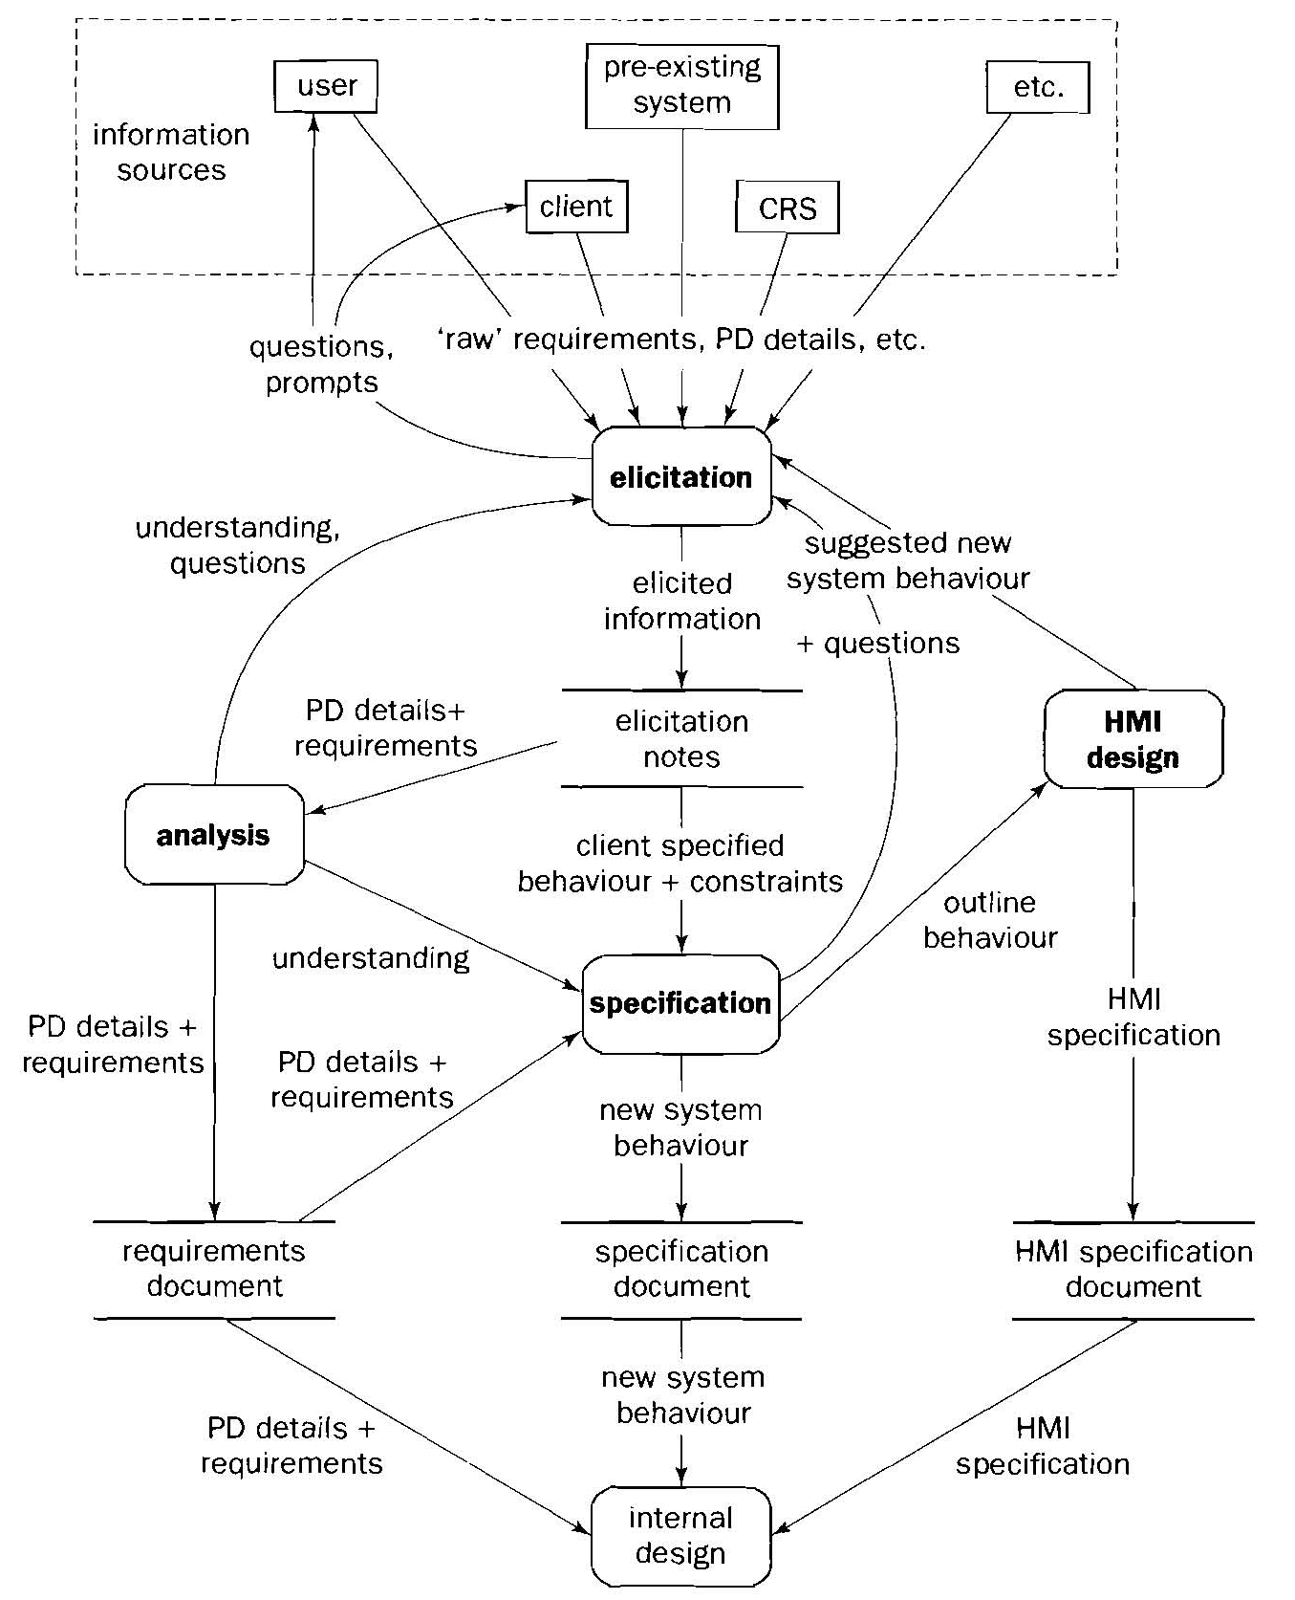
An iterative Model of RE Process
(Bray 2002, p31)
Abbreviations:
CRS: Client Requirements Statements
HMI: Human-Machine Interface
PD: Problem Domain

Slide 18
RE Lifecycle: 3. Products
Problem statement
  Initial statement of the problem, its context and its overall objectives
Requirements definition
  Document that systematically state the requirements:
    The problem
    The organisational and technological context
    The objectives
    The functional requirements
    The non-functional requirements
    The scope of the system and priorities of each requirements, etc.
Requirements specification
  Document of functional requirements in accurate notations, such as in graphic models or formal notations

Slide 19
Lecture 3
Requirements Engineering
Part 2
Requirements Elicitation

Slide 20
Requirements Elicitation: Definition
Requirements elicitation involves finding all types and all aspects of requirements from all relevant sources at a required level of details for the system to be developed.
Types
Functional
Non-functional
  Quality requirements
  Architectural constraints
  Development constraints
Aspects
Functional Non-Functional
- Function - Attribute
- Data - Measurement
- Interface - Precision
- State - Target value
- Events
Sources
-- Stakeholders
-- Documents
-- Existing system
-- Models of the system
Activities
-- Identify sources
-- Discover existing requirements
-- Develop new requirements

Slide 21
Elicitation Methods & Techniques
Main Techniques
  Interviews
  Questionnaires
  Workshops
    Future workshop
    KJ method
    Brainstorming
  Observations
  Document reading
Assistance Techniques
  Prototyping
  Mind mapping
  Elicitation check list
  Focus groups

Slide 22

Elicitation Techniques: 1. Interviews
In this technique, the requirements analyst conducts interviews with stakeholders
  To discuss the system with the stakeholders
  To develop an understanding of their requirements
Types of Interviews
  Closed interviews:
    Requirements analyst seeks
    answers (from stakeholders) to
    a pre-defined set of questions
  Open interviews
    Do not have predefined agenda. Requirements are discussed in an open-ended way (to find out what stakeholders want from the proposed system)

Slide 23
Example: Interview Plan
Plan for the first interview with Budget Airline
ABC Software: Interview Plan
Project Reference: AA/ER/07
Participants: J. Smith (Budget Airline) C. Chung (Budget Airline) A. Marshal (Analyst)
Date: 02/10/2013 Time: 2:00 PM Duration: 30 minutes Place: Room C212
Purpose of the interview: Preliminary meeting to identify problems and requirements regarding software system for Budget Airline Flight Booking System.
Agenda: current problems including booking, checking flight schedule, and any other concerns current procedures initial ideas follow up actions
Documents to be brought to interview: Current Procedures of Flight Booking

Slide 24
Interview Questions
Questions should be properly constructed to enable you to get useful information.
  Closed questions:
    Different response options are provided. The interviewee can choose one or multiple responses.
    Useful to confirm certain known information
  Open questions:
    No predefined responses are provided to the interviewee. The interviewee can answer the question in his own words.
    Useful to find out new information
  Leading questions: suggest the answers to the interviewee
    Often starts with “Don’t you think that …?” “Isn’t it true that …?”
    Often lead to bias, thus should be avoided in requirements elicitation

Slide 25
Elicitation Techniques: 2. Questionnaires
Requirements elicitation by questionnaires means:
  Setting a number of questions about the required system and the requirements,
  Asking instances of a given target stakeholder to write down their answers to these questions
It is effective when the required information is:
  a small amount
  contents in a well-defined context
  from a large number of people, especially if widely scattered, to establish a consensus

Slide 26
Example: Questionnaire
Budget Airline Flight Booking System – Customer Survey
We are intending to move to a new online flight booking system in a near future. It would be a great help to us if you could spare a few minutes to give us your opinion. Please, answer the question below and return it within 1 week in the enclosed pre-paid envelope.
------------------------------------------------------------------------------------------------------
1. How many times have you bought tickets using our current phone service?
Once only [ ]
2-4 times [ ]
More than 4 times [ ]
-----------------------------------------------------------------------------------------------------
2. Have you experienced problem with our service?
No [ ]
Yes [ ], please explain briefly below:
………………………………………………………………………………
………………………………………………………………………………
Closed questions

Slide 27
Example: Questionnaire (Continue)
3. For each of the statements (a) – (e) shown below, circle the number that is closest to your view – where 1 means you agree strongly with the statement and 5 means you strongly disagree.
(a) The current phone service works well 1 2 3 4 5
(b) The staff are always helpful and friendly 1 2 3 4 5
(c) It is difficult to get flight schedule 1 2 3 4 5
(d) Online booking will be more convenient 1 2 3 4 5
(e) I would like to buy tickets online 1 2 3 4 5
-------------------------------------------------------------------------------------------------------------
4. Please note below any other comments:
………………………………………………………………………………….
………………………………………………………………………………….
Your name: ……………………………………………
Your Email: …………………………………………
Thank you for completing the questionnaire
Quantitative question
Open question
27

Slide 28

Elicitation Techniques: 3. Workshops
In a workshop, a group of stakeholders develop requirements for the system by working together through discussions
Different forms of workshops
  Future workshop
  KJ Method
  Brainstorming

Slide 29
Future Workshops
Views users as experts in the problem domain and aims to include them as active collaborators in the development process
  Originated in Scandinavia
  Also called Participatory Design
It is divided into three stages:
  Critique: current problems in the current system
  Fantasy: imagine the perfect future system
  Implementation: discuss ways in which the fantasy view may be realized

Slide 30
Brainstorming
It is a creativity technique that aims to generate a large number of new ideas by stimulating discussions with a group of stakeholders in the form of a workshop.
Process
  Presentation of the subject
    Explain the subject
    Clarify the goal of the session
    Set the rules of brainstorming
  Idea generation
    Each participant expresses his/her ideas with respect to the subject
    Minute taker records all ideas and make them visible to all participants

Slide 31
Seven Rules of Brainstorming
Quantity over quality
Free association and visionary thinking encouraged and desired
Taking on and combining expressed ideas is encouraged and desired
Criticism is forbidden
Questions for clarification are allowed
Do not abort the brainstorming at the first deadlock
  Almost every brainstorming session experiences a slack period (30-60 seconds of silence).
The brainstorming comes to a natural end
  Indicated by increasing frequency and lengths of deadlocks
31

Slide 32
Elicitation Techniques: 4. Observation
Observation is a method of social analysis widely used in a methodology called ‘Ethnography’
  Originated from social sciences and anthropology
  Is an umbrella qualitative research methodology that relies on immersion into the culture and is designed to explore cultural phenomena
  Ways for understanding actual work processes – how people work at workplaces, e.g. organisational practice and culture
The analyst (ethnographer) spends time with people at work to gain an understanding of actual work practices
  Establishes a trust relationship with people at work
  Keeps detailed notes of all work practices
  Talks to people outside the workplaces to get required information
  Analyses the information collected and draws conclusions
  Very useful technique, but time consuming

Slide 33
Lecture 3
Requirements Engineering
Part 3
Requirements Documentation

Slide 34
Requirements Documentation
Requirements documentation
  One of the key engineering activities in RE
  Aims at documenting important information elicited or developed during RE
Terminology
  Documentation:
    The activity that produces, archives and manages software artifacts in the engineering process
  Document:
    The artifacts produced by documentation and usually written in a natural language

Slide 35
Roles of Documents in RE (and SE)
To provides persistent and reliable record of information
To facilitate communications between stakeholders as common references
To serve as a reference and/or contract in the negotiation and agreement of commissioning development tasks
As the basis for further development, such as design, derivation of operation manual, etc.
To preserves expert knowledge
To help reflection on the problems

Slide 36
What to Be Documented
Intermediate results
  Brainstorming results
  Different stakeholders’ viewpoints
  Alternative solutions for resolving conflicts
  Information about context
  Deviations from standards, rules and guidelines
  Identified requirements
  Review/walkthrough results
  Scenarios
  Stakeholder’s wishes, needs, arguments
  Requirements sources
  Context information
  Stakeholders
  Risks
Problems identified
  Errors
  Contradictions
  Gaps in documented requirements
Decisions made
  Agreement reached on requirements
  Decision regarding conflicts
  Decision rationales
  Priorities on requirements
Evolution of artifacts
  Change requests
  Decision about change requests
  Evolution tracks
Final results
  Requirements definition
  Requirements specification

Slide 37
Documentation vs Specification
Specification is a special sub-type of RE documents aiming at providing a definitive and clear document about the system to be developed
  Represent the final results, agreed by all stakeholders, especially the client
  Provide the technical details of the project contract
  Serve as the development and acceptance manual
  Often employ formal/semi-formal notations, such as modelling languages and/or mathematical notations
Specified requirements
Documented requirements
Documented information

Slide 38
Quality of Requirements Documents
Completeness
Traceability
Correctness
Unambiguity
Comprehensibility
Consistency
Verifiability
Atomicity

Slide 39
Common Errors: Intermingled Statements
Include several requirements in one sentence
A common problem of using natural language to write requirements document. For instance,
  intermingling functional and non-functional requirements in one sentence
This easily causes a requirement being overlooked
Example: Mobile Restaurant Online Booking
  Intermingled sentence:
    “The system should send discount promotions to registered customers regularly via email”.
  Separate functional and non-functional:
    Functional: (F1) The system shall send discount promotions to registered customers.”
    Non-functional:
    (N1) The discount promotions should be sent once every week.
    (N2) The discount promotions should be sent by email.

Slide 40
Uses of Natural Languages
Advantages
  Expressiveness
    It can be used to describe to an arbitrary level of abstraction, precision and accuracy
  Comprehensibility
    It can be relatively easy to comprehend even for users with little training
  Applicability
    It is applicable to all aspects of all types of systems
Disadvantages
  Ambiguity
    Natural language is inherently ambiguous

Slide 41
Types of Ambiguity in Natural Language
Lexical ambiguity:
  synonyms, homonyms
Syntactic ambiguity:
  one sentence may have two different ways to parse
Semantic ambiguity:
  a sentence may have two or more meanings in different context
Referential ambiguity:
  the relation between a word or phrase in a sentence and an expression before or after this word or phrase have more than one possibility
Vagueness of terms:
  a word/phrase is inherently unclear about its meaning
Notes:
1. Lexical Ambiguity
A single word has multiple meanings.
Requirement: "The system must reject a batch if it contains an error."
Ambiguity: Does "batch" refer to a group of students, a quantity of baked goods, or a set of data records? The word itself is ambiguous without context.
2. Syntactic Ambiguity
The sentence structure is grammatically unclear, leading to multiple interpretations of the relationship between words.
Requirement: "The system shall show the technician and the manager the report."
Ambiguity: Is there one report that is shown to both the technician and the manager? Or are there two separate reports: one for the technician and one for the manager? The structure "show A and B the report" is syntactically ambiguous.
3. Semantic Ambiguity
The meaning of a statement or phrase is open to interpretation, even if the words and grammar are clear.
Requirement: "The website must have a fast response time."
Ambiguity: What does "fast" mean? Is it 100 milliseconds, 2 seconds, or 5 seconds? The intended meaning is not precisely defined.
4. Referential Ambiguity
It is unclear what a pronoun ("it," "they," "that") or a phrase ("the previous one") refers to.
Requirement: "When the customer submits an order and a complaint, it must be logged immediately."
Ambiguity: What does "it" refer to? The order, the complaint, or the entire customer submission event? The reference is unclear.
5. Vagueness of Terms
A term has borderline cases because it lacks a clear, sharp boundary.
Requirement: "The system must provide support for large files."
Ambiguity: What is the threshold for a "large" file? Is a 10MB file large? What about 100MB or 1GB? The term is vague and subjective.

Slide 42
Techniques to Avoid Ambiguity
Syntactic pattern
  Define a pattern of syntactical structure in which statements are written
  To avoid syntactical ambiguity
Controlled language
  Extends syntactic patterns with semantics of terms
  To reduce both syntactic and semantic ambiguity
Glossary
  List a collection of technical terms and their meanings
  To avoid ambiguity of terms

Slide 43
Syntactic Patterns: 1 [Rupp 2009]
A syntactic pattern defines a syntactic structure for writing the statements of requirements in natural language and defines the meanings for each part of the structure.
<process>
Provide <whom> with the ability to <process>
Be able to <process>
System’s name
shall
should
will
[<details of the object>]
[ <when> ]
The system
<object>
Logical/temporal condition of the action
Indicate the importance of the requirement

Slide 44
Example:
<when>
If the glass break detector detects the damage of a window, the system shall inform the security service.
<process>
<object>

Slide 45
Syntactic Patterns: 2 [Zhu et al. 2001]
Actor, object, component, the system
<Entity> <Action> <Object> <Receiver entity> <Constraint>
The function, action, ability, etc.
The condition, limitation, etc.
Example:
Entity
Action
Object
The system sends the review results and the decision on acceptance/rejection of a paper to the author when the conference PC chair issues the decision.
Receiver
Constraint

Slide 46
Controlled Languages
A controlled language is defined for a specific application domain with a restricted natural language grammar (syntax) and a set of terms (including their semantics) to be used to document statements in the domain.
Advantages:
  Easy to understand: they are similar to expressions in natural language
  Less ambiguous: they have simplified grammar and predefined vocabulary with precise meanings
  More verifiable: they are easier to check for grammar and semantics errors

Slide 47
Glossaries
A glossary defines the specific meanings of a collection of technical terms that are part of a language. It may also contain references to related terms as well as examples to explain the defined terms.
The definition of a term in a glossary may contain the following parts:
  The term to be defined
  The definition text
  Synonyms
  The related terms and the relationship (such as generalisation, specialisation, etc.)
  Examples/counter-examples

Slide 48
Example of Glossary
Term: | Route
Definition: | The specific instance of a direction from a starting point to a destination
Synonyms: | Itinerary
Related terms: | Primary route (specialization)
Example: | The system should give a link to a map that shows the route from starting point to the destination.

Slide 49
Structures of Requirements Document
Requirements documents should be structured
  As defined by a company standard
  Checked as a part of the document quality assurance process
  In the best way to suit your organisation’s business
  May have variants from a single standard for different types of systems
Industrial wide standards
  IEEE 1233-1989: for system requirements definition
  IEEE 830-1998: for software requirements definition

Slide 50
IEEE Standard 830-1998
Table of Contents
Introduction
1.1 Purpose of this document
1.2 Scope of the product
1.3 Definitions, acronyms and abbreviations
1.4 References
1.5 Overview of the remainder of the document
2. Overall Descriptions
2.1 Product perspective
2.2 Product functions
2.3 User characteristics
2.4 Constraints
2.5 Assumptions
3. Specific Requirements
Appendix
Index
The section on specific requirements can be structured in many ways, such as according to
Operation mode,
User classes,
Objects,
Features,
Stimulus
Responses
Functional hierarchy,
etc.

Slide 51
Structure of Specific Requirements
3. Specific requirements
3.1 External interface requirements
3.1.1 User interfaces
3.1.2 Hardware interfaces
3.1.3 Software interfaces
3.1.4 Communication interfaces
3.2 Functional requirements
3.3 Performance reqs
3.4 Logical database requirements
3.5 Design constraints
3.5.1 Standards compliance
3.5.2 hardware limitations
…
3.6 Software system attributes
3.6.1 Reliability
3.6.2 Availability
3.6.3 Security
3.6.4 Maintainability
3.6.5 Portability
…
3.7 Other Requirements

Slide 52
Mode-Based Functional Requirements
Give the name of the operation mode. For example,
Emergent stop,
Downgraded maintenance,
Initialisation,
Normal operation, etc.
3.2 Functional requirements
3.2.1 Mode 1
3.2.1.1 Functional requirement 1.1
…
3.2.1.n Functional requirement 1.2
3.2.2 Mode 2
…
3.2.m Mode m
3.2.1.1 Functional requirement 1.1
…
3.2.1.n Functional requirement 1.2
List the functional requirements for the system when it is in the operation mode

Slide 53
User-Based Functional Requirements
Give the name of the user type/class. For example,
Author,
Reviewer,
PC Chair,
Administrator, etc.
3.2 Functional requirements
3.2.1 User class 1
3.2.1.1 Functional requirement 1.1
…
3.2.1.n Functional requirement 1.2
3.2.2 User class 2
…
3.2.m User class m
3.2.1.1 Functional requirement 1.1
…
3.2.1.n Functional requirement 1.2
List the functional requirements for the type of users

Slide 54
This Week’s Study Guide
Further Readings
  Klaus Pohl, Requirements Engineering: Fundamentals, Principles and Techniques, Springer, 2010. (Chapter 16 – 18, pages 293– 348, 21 and 22, pp391-450)
  Alan Dennis, Barbara Hayley Wixon and David Tegarden. System Analysis and Design with UML: An Object-Oriented Approach, (3rd Edition). Wiley, 2010. (Chapter 4. pp110-149)
  Alex van Lamsweerde. Requirements Engineering: From System Goals to UML Models to Software Specifications. Wiley, 2009. (Chapter 2, pp61-86, Chapter 4, pp120-127)
  Ian K. Bray. An Introduction to Requirements Engineering. Addison Wesley, 2002. (Chapter 3, pp41-49, Chapter 5, pp135-203)

